Slide 1






On

Slide 2

Who and What is being Presented?
Introductions : Ntsane Kolisang
Project Management : Ntsane Kolisang
Project 5W+H
Risk Management
Challenges and Solutions
Business Flow
Analysis : Giovanna Contu
High Level Context Diagram
Design : Abram Rankapole, Tsungai Makoni
Screen Evolution and Usability Testing
Applied HCI Heuristics
Implementation : Ronald Chinku, Dusan Gnjatic
Scenario Demonstration
Lessons Learned : Ntsane Kolisang
Questions and Answers : Interactive - Examiners

Slide 3


Project Management
Ntsane Kolisang

Slide 4



Who are The Stakeholders ?
The Project Team :
Our Customer :
Our End User :
The Facilitator :

Slide 5

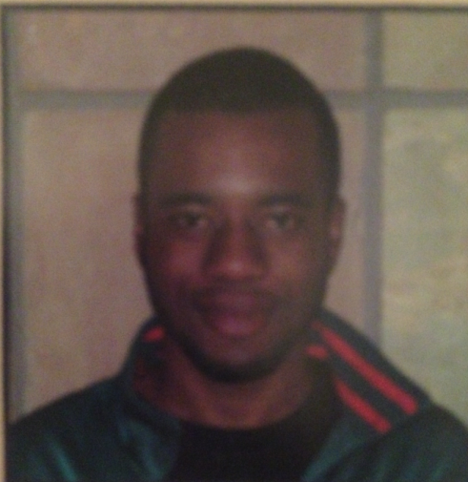
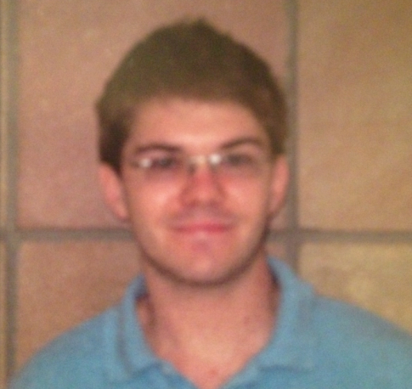
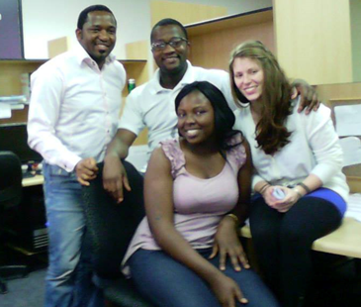
Who is Project Team ? ITS-Africa
Dusan Gnatic
Ronald Chinku
Ntsane Kolisang, Abram Rankapole
Tsungai Makoli, Giovanna Contu

Slide 6
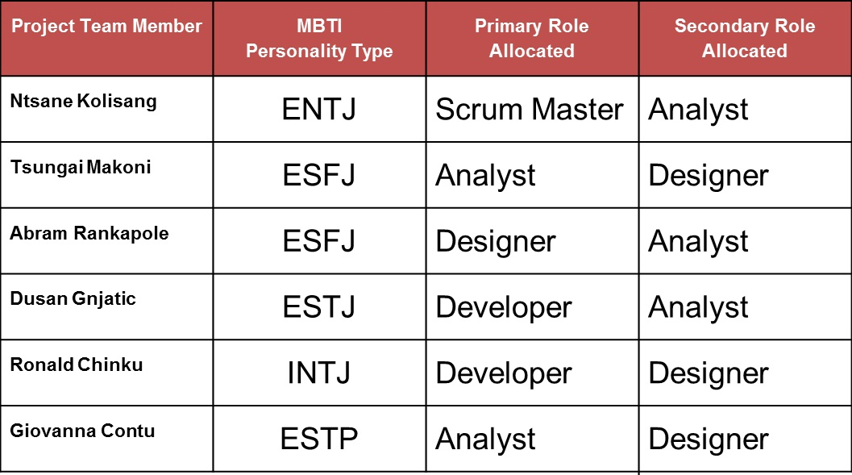
Roles and Team Contract

Slide 7

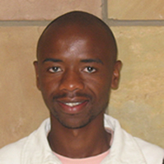
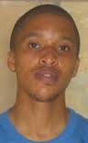
Who is The Client ? Reedhouse Systems
Prof. Alfredo Terzoli
Mr. Okelitse Nyathi
Dr. Moses Tsiesi

Slide 8
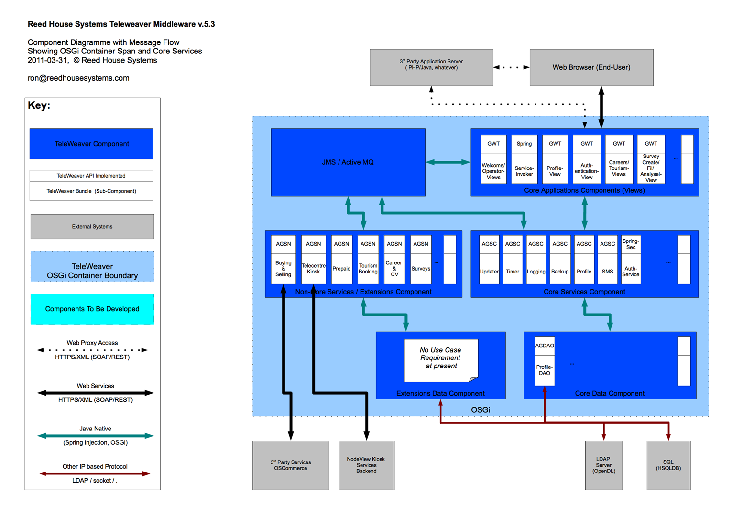
Who is The Client ? Reedhouse Systems

Slide 9
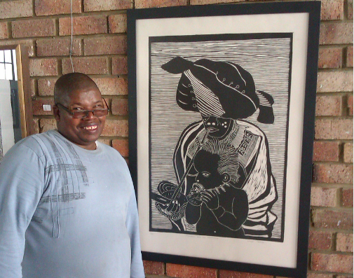
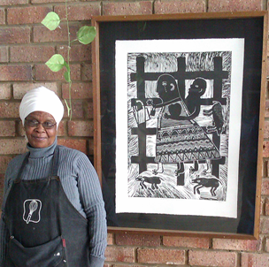
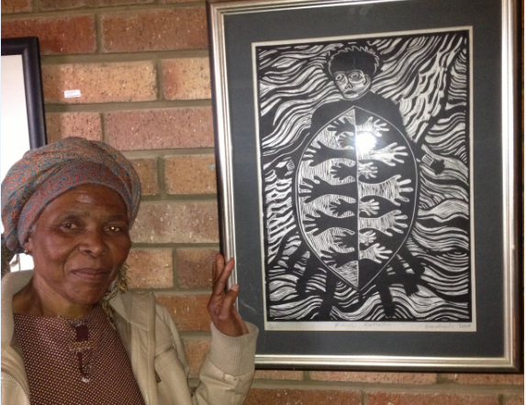
Who is The End User ? Egazini
Mr. Vukile Teyise
Mrs. Violet Booi
Mrs. Noluthando Tana

Slide 10
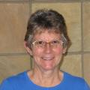

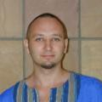
Who is The Facilitator? IS Department
Mrs. Lydia Palmer
Dr. Caroline Khene
Mr. Ed de la Rey

Slide 11
What is the Project Objective ?
To project manage, develop, install, test and commission an android platform mobile application for Reed house Systems to be used by Egazini Outreach Project.

Slide 12
What is The Project Scope ?
Project Scope :
Develop, install, test and commission the front-end mobile application for the Reed House e-Commerce System. The application will connect to TeleWeaver using RESTful(REpresentation State Transfer) webservices.
Project work exclusion Scope:
We are not developing anything on the administrator or TeleWeaver's side.
We are not developing anything on the buyer's side.
We are not handling delivery and payment systems.

Slide 13
Where and Why ?
Where?
In Grahamstown, Egazini marginalised Community.
Why?
To Enable Reed house Systems clients to use their phones and upload their artwork ware to TeleWeaver and sell it to a broader market.

Slide 14
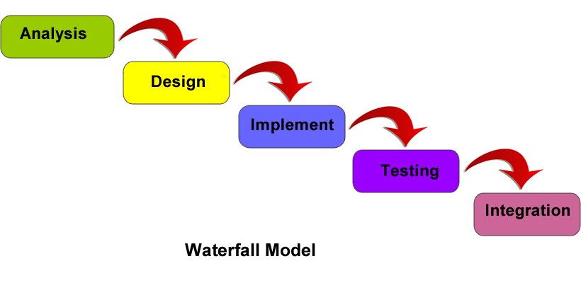
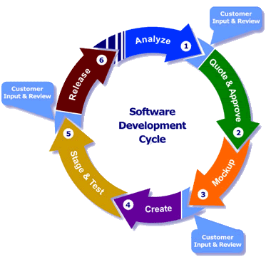
When and How ?
Time : Project needs to be completed by the end of October 2013
Waterfall and Agile Approach

Slide 15
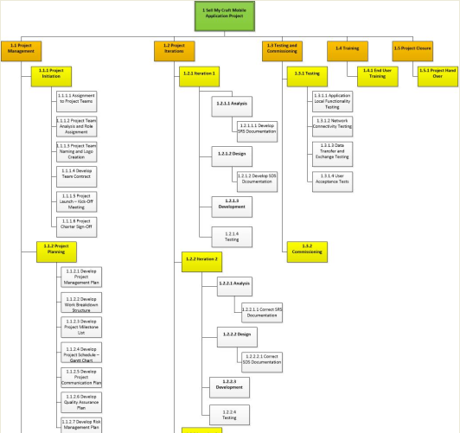
WBS

Slide 16
Key Changes On WBS
Overall Project Scope Definition Change
Analysis and Design of Activities within Teleweaver side
Application HCI Change
Database Schema Changes for Synchronisation with Teleweaver Change

Slide 17
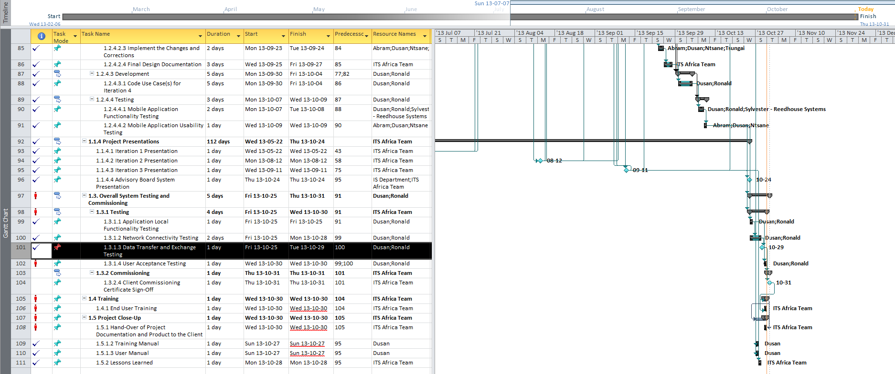
Project Scheduling : Gantt Chart

Slide 18
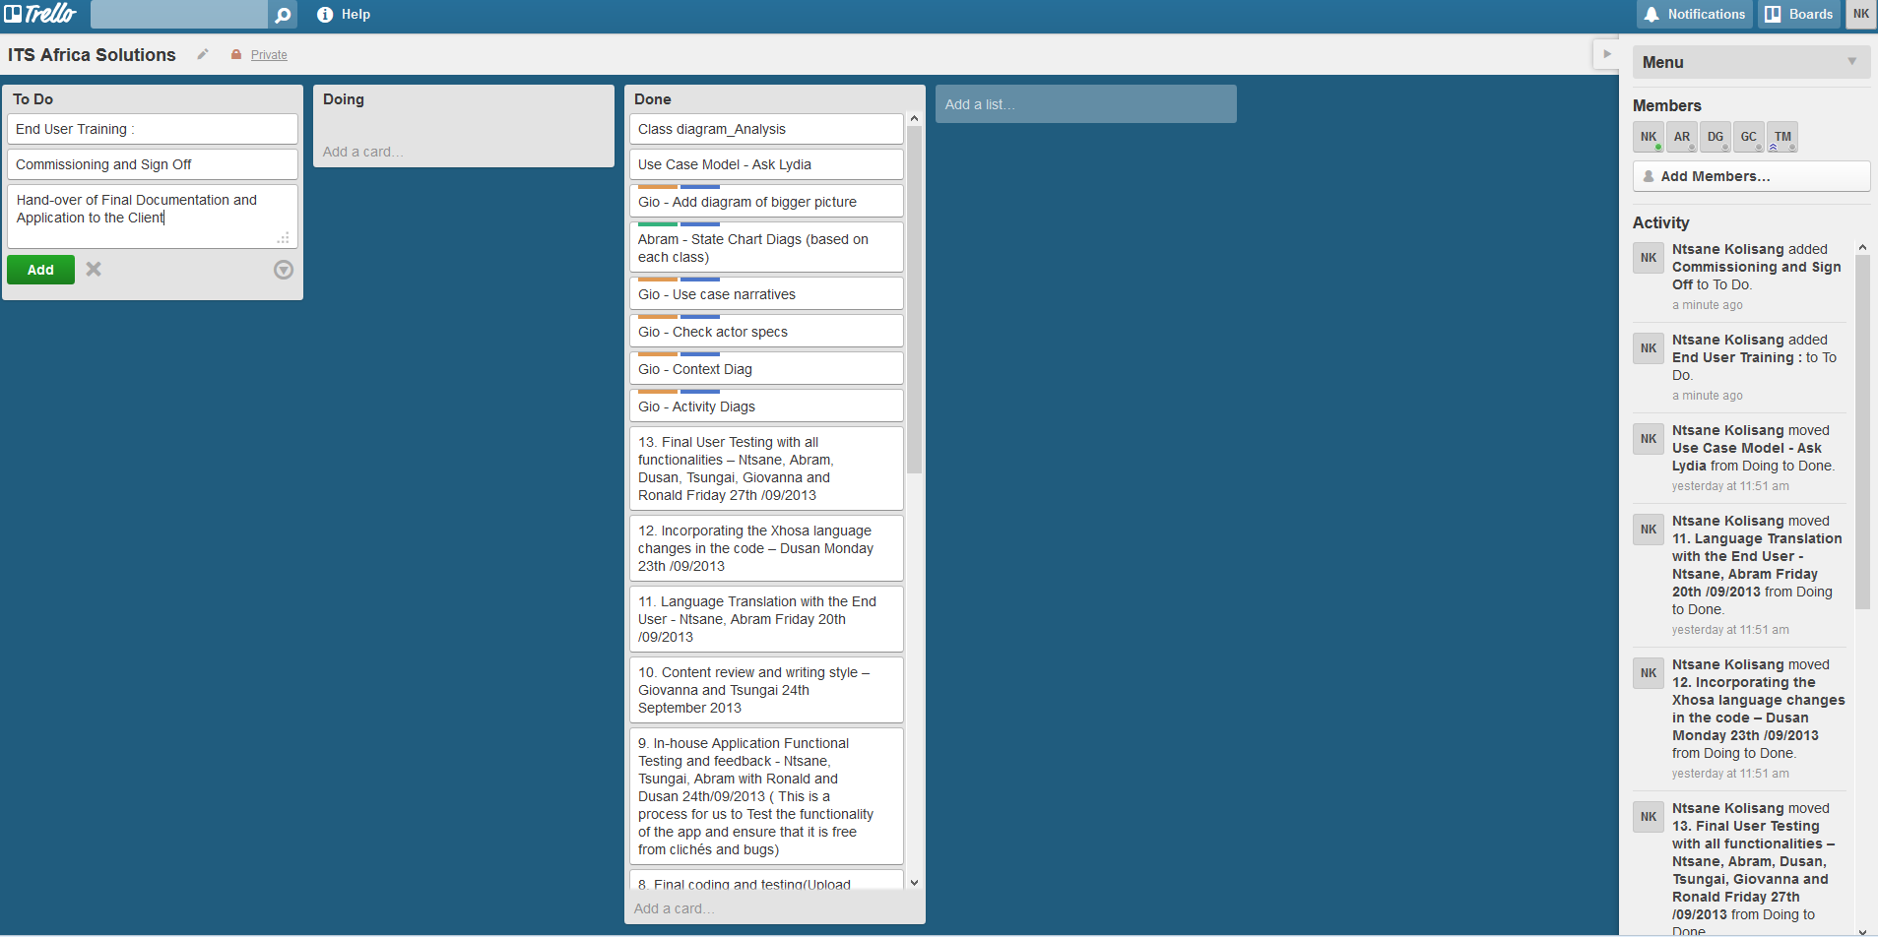
Task Tracking and Management

Slide 19
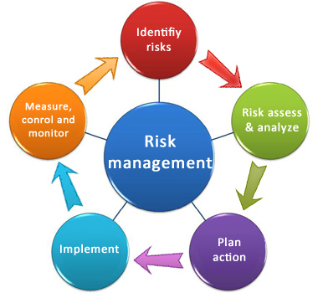
Risk Management :
No. | Potential Risk | Category | Root Cause | Triggers | Potential Responses | Risk Owner
1 | Misunderstanding of the requirements | Requirements Risk | Poor Interpretation of the End User and Customer requirements. Poorly defined customer requirements. | End-user and Customer commentary during project meetings, JAD sessions or during testing | Have a JAD Session with the end-user and the customer. | Analyst
2 | Conflict between the end-user and the customer | Key Stakeholder | Nonaligned project objectives. | User not satisfied with the end product | Enable a Jad Session to align objectives | Project Manager
3 | Communication breakdown | Communication | Not providing feedback or communicating things on time. | Lack of communication devices or medium | Ensure that there is a wide range of communication devices that are being used throughout the project | Project Manager
4 | Conflict between the team members | Organisational Risk | Personalities not getting along. | Poor work ethic. Stress. | Hold and internal meeting and discuss issues with the purpose of ensuring compliance to the team agreement | Project Manager
5 | Technology Complexities | Technical Risk | Lack of knowledge | In ability for make features of the program to work | Get assistance from ICT expertise available from the department and the customer’s side. | Programmer
6 | A non-user centred design | Technical Risk | Not involving the user during the development of the system | Commentary during testing | Ensure that end-users are involved extensively in the project. | Designer

Slide 20
Challenges and Solutions
Find the End-User : From Dwesa to Egazini
Internal Meetings : Skype
Communication : Xhosa and English
Scope Definition : Local Database or not
Networking : Restful Webservices and JSON
Basic4Android : Lack of Support
End-user Usability Testing:
Touch Screen Technology unfamiliarity - Training
Language Factor - Iconography

Slide 21

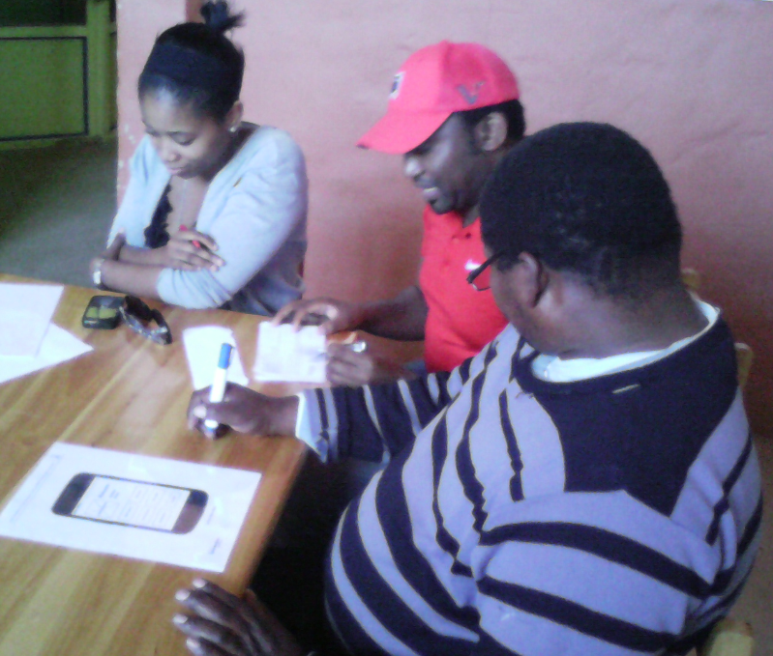
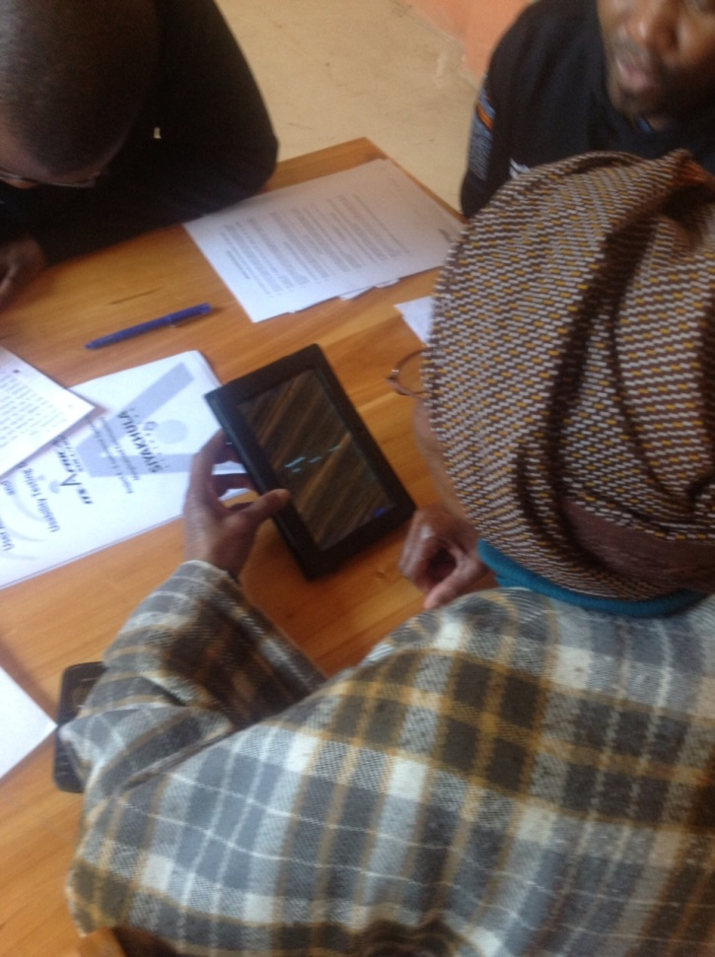
Power rests with the End User
Paper Prototype Testing
Device Usability Testing

Slide 22
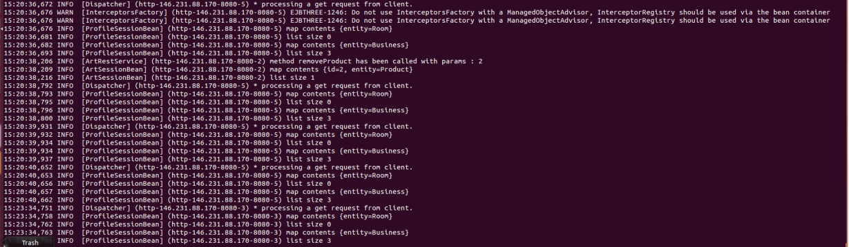
Challenges & Solutions
Language localisation :Hardcoded Xhosa.
Lost in Translation : End User Definitions
Synchronise : JAD and Technical Meeting
Log Print for Get request

Slide 23

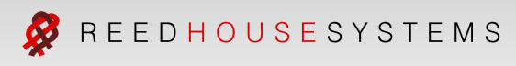





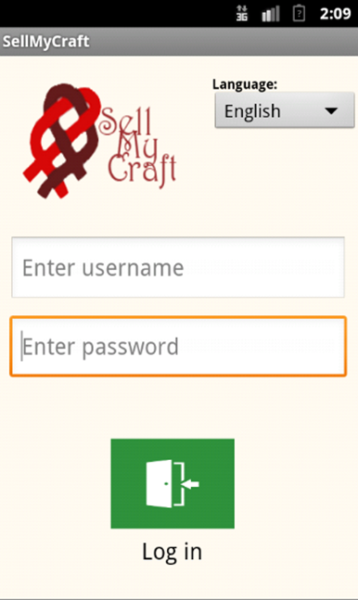


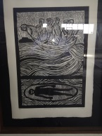



Business Flow
RESTful web
services
(JSON)
Teleweaver
1. Register
TeleCentre
Access node
Wi-Fi
6. Payment and Sales
2. Login
3. Manage Profile
5. Upload to TeleWeaver
Vendor
4. Save Artwork
7. Sales Report
End user Artist
Mobile Application (on Android phone)
Artwork for sale
Buyer

Slide 24
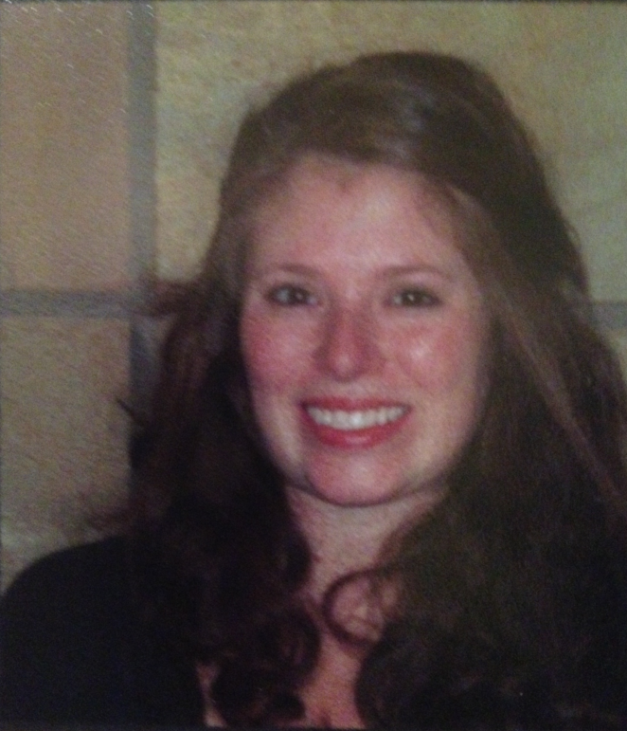
Analysis
Giovanna Contu

Slide 25

Context Diagram
Artist
Artist
Product pictures
Product details (Picture details)
Artist details
Gallery (product pictures)
Sales report
Inventory report
Profile preview
Sell My Craft Mobile
Application
Product pictures
Product details (picture details)
Sales details
Artist details
Payment notification
Sales Details
TeleWeaver
TeleWeaver

Slide 26

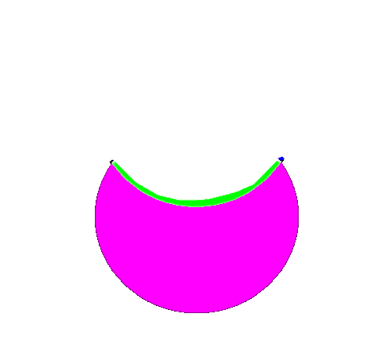
Artist
Gallery (product pictures)
Sales report
Inventory report
Profile preview
Artist
Product pictures
Product details
Artist details
Sell My Craft Mobile Application
(offline)
(offline)
(online)
TeleWeaver
Payment notification
Sales details
(online)
Access Control
Synchronisation (product pictures, artist details, product details)
TeleWeaver
Access request
Restful Web Services
Artist
Technical access information
Login details
Sale notification (email/SMS)
Payment
TeleWeaver System
Artist
Registration details
Product pictures
Product details
Sales details
Vendor
Buyer
Payment details
Sales details
Sales confirmation
Products
Buyer

Slide 27
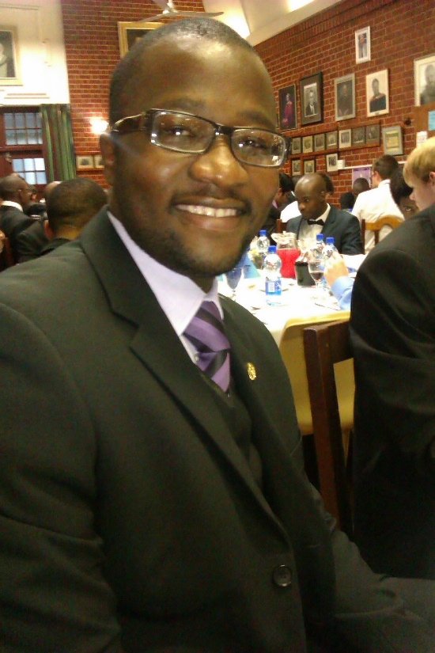
Design: Screen Evolution Usability Testing
Abram Rankapole

Slide 28
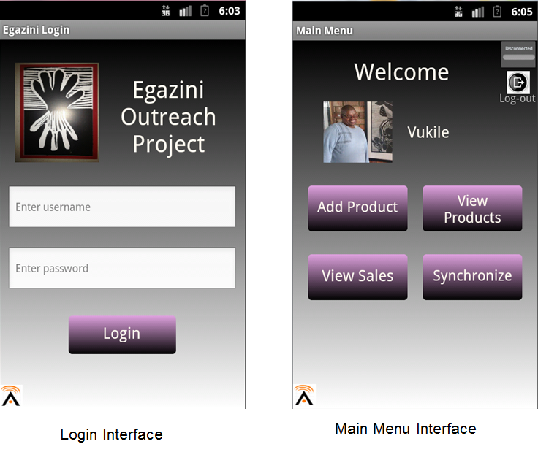
Evolution of the Application Design

Slide 29
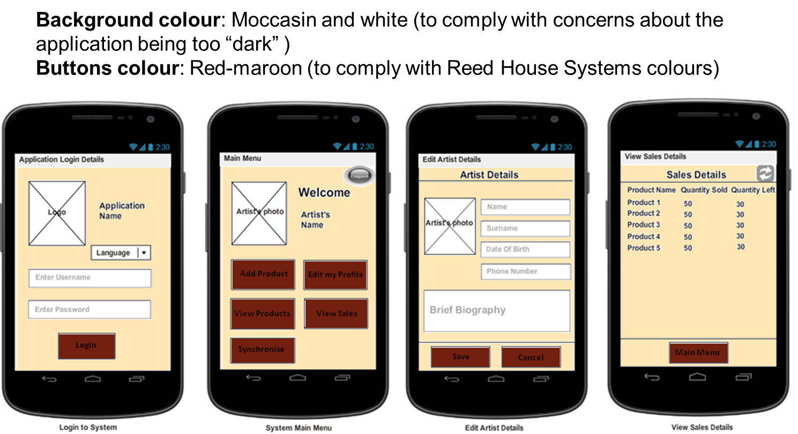
Evolution of the Application Design

Slide 30
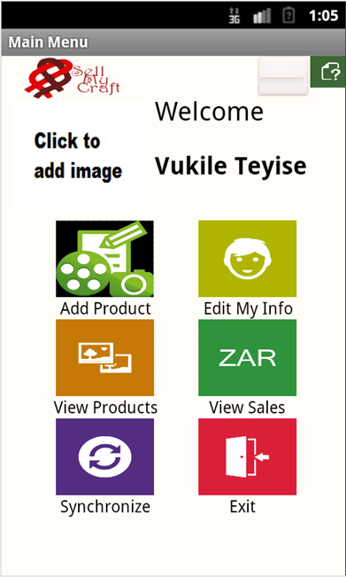
Evolution of the Application Design

Slide 31

Design: Applied HCI Heuristics
Tsungai Makoni

Slide 32
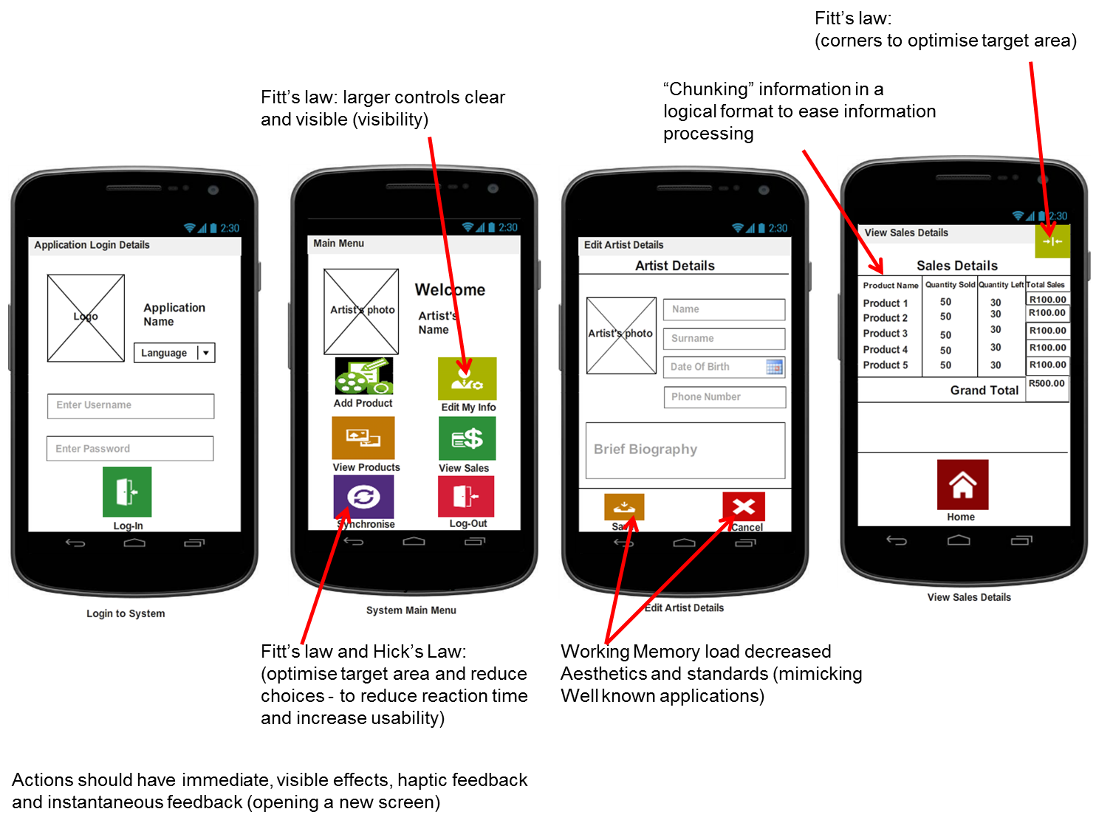

Slide 33
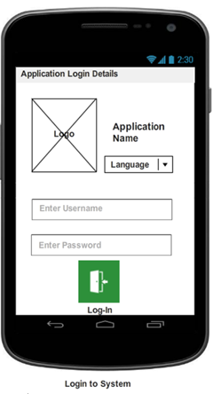
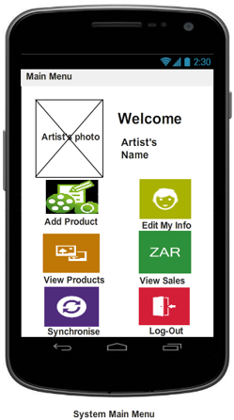
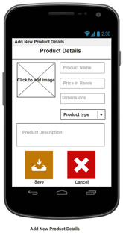
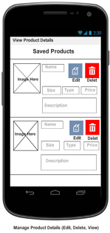

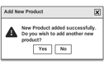
General Screen Navigation Flow

Slide 34


Implementation
Ronald Chinku,
Dusan Gnjatic

Slide 35


Implementation
Scenario :
Add Product
Edit Product/ Delete Product
Sychronisation Sales

Slide 36
Lessons Learned
Team Size and Capability (knowledge, skills, experience)
Lessons from the Client, End User and Facilitator
Development Software and Support
Mobile Platforms (Basic4Android)
Access to Information
ICT4D in Action ( Hope for us all)

Slide 37
Q&A
Questions and Answers

